Slide 1
Data structures

Slide 2
Data structures are a way of organizing and storing data so that they can be accessed and worked with efficiently
1 :- LIST
2 :- TUPLE
3 :- SET
4 :- DICTIONARY
5 :- STRING

Slide 3

LIST
1 :- list is a collection of things, enclosed in [] and separated by commas ,
list is mutebale , idexble
dublicate and different also allow in list and slicing possible
OUTPUTE = [ 1,2,4,33,11,22,44,44,”roll”

Slide 4

tuple
Tuples are used to store multiple items in a single variable.
enclosed in ()
tuple is inmuteble
OUTPUT = <class ‘tuple’>

Slide 5
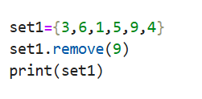
set
Set is a data type in python used to store several items in a single variable.
represnting by []
set is mutebale
OUTPUT= {1,2,4,5,6}

Slide 6
Dictionary
Dictionary A Python dictionary is a data structure that allows us to easily write very efficient code. In many other languages, this data structure is called a hash table because its keys are hashable. We'll understand in a bit what this means. A Python dictionary is a collection of key:value pairs.
OUTPUT={‘name’: “soham , ’age’: 32 , ‘city’: pune

Slide 7
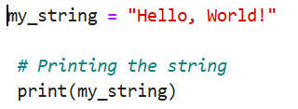
string
String is a collection of alphabets, words or other characters
Represnting by = ‘ ‘ , “ “, “”” “””
OUTPUT= Hello,world!

Slide 8
Data types
 | LIST | TUPLE | DICTIONAY | SET | STRING
MUTEBLE | YES | NO | YES | YES | NO
IMMUTEBLE | NO | YES | NO | NO | YES
REPRESENTIG BY | [ ] | ( ) | { } | { } | ‘A’ “A” “”” A”””
DUBLICATE ALLOW | YES | YES | KEY IS NOT ALLOW VALUE ALLOW | NO | NO
DEFRENT TYPE | YES | YES | NO | YES | NO
IDEXBLE | YES | YES | NO | NO | YES
SRTICING | YES | YES | NO | NO | YES

